Slide 1

Spotify Popularity Prediction
Team 7
Hao CHEN
Jingzhe LI
Siting DONG
Yizhuang PENG
Zhiqi LI

Slide 2
BUSINESS
CONTENTS
1
Background Information
Company Overview
Business Issue & project Aim
Dataset Selection.
2
Data Visualizations
3
4
Modeling & Results
Data Preparation
First Model-Logistic Regression
Second Model-Decision Tree
Third Model-Random Forest
Model Comparison
5
Recommendations
Text Analysis

Slide 3

01.
Background Information
Company Overview
Business Issue & project Aim
Dataset Selection

Slide 4

01.
Background Information
02.
Data Visualizations
03.
Modeling & Results
04.
Recommendations

Slide 5


Company Overview
Online music streaming service platform
The world's largest streaming music service providers.
In 2019, the monthly active users of Spotify arrived at 271 million, which contributed to $8 billon revenue.

Slide 6

Business Issue & project Aim
Issue
$6 billion royalties paid per year → Low Profit Margin
Project Aim
help Spotify reduce their investment in royalties which could lead to the surge of profit margin.
Approach
Identifying what attributes made a song popular

Slide 7

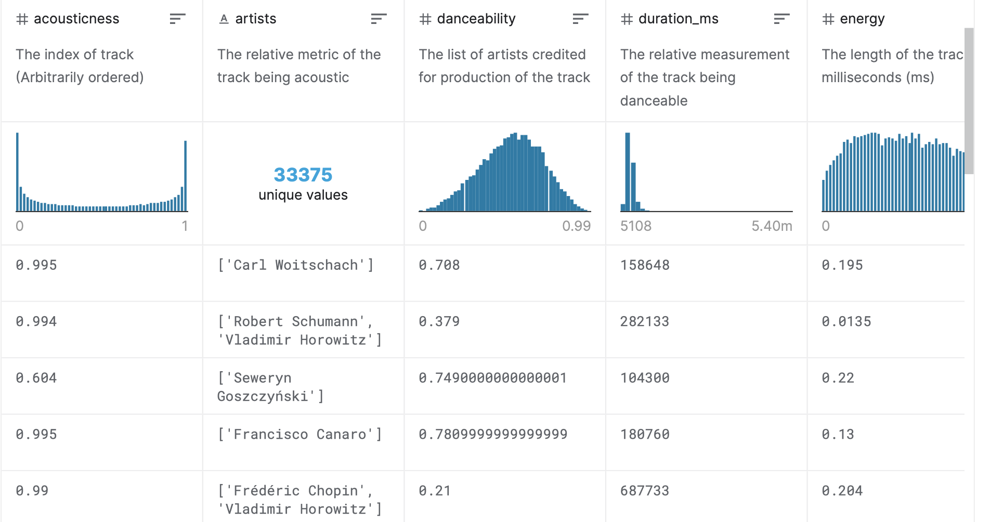
Dataset Selection
Nearly 120,000 songs in Spotify from 2015-2020, contains the information about the attributes of songs.
For example, acousticness, danceability etc.

Slide 8
02.
Data Visualization

Slide 9
01.
Background Information
02.
Data Visualizations​
03.
Modeling & Results
04.
Recommendations

Slide 10
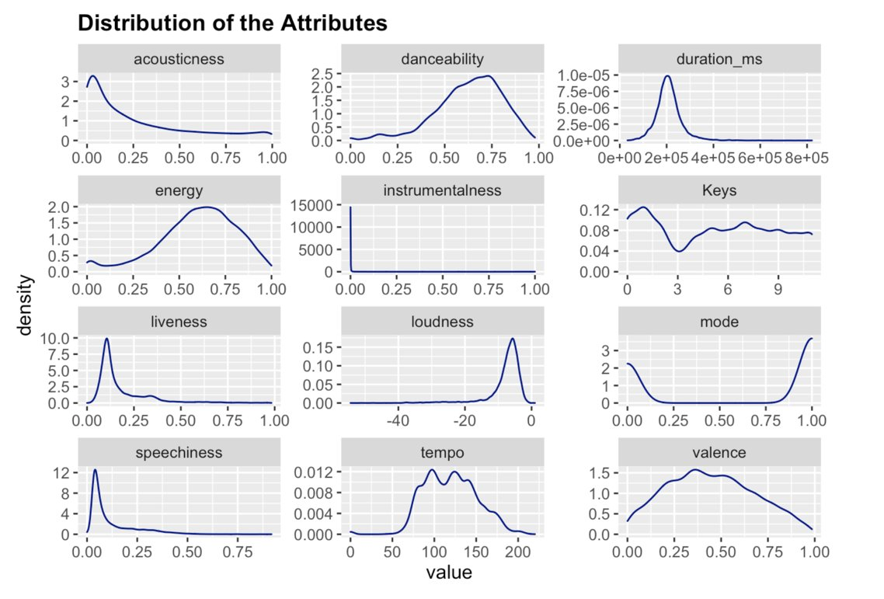
c
Some variables are heavily skewed, e.g. instrumentalness
Variables are of different scale, and thus require certain normalization
Notes:
We could see the distribution of the variables from this graph. Some variables are heavily skewed. For instance,most of the values fall close to zero for the attribute instrumentalness, which lead to the heavily right-skewed distribution. #The attributes are also of different scale and thus certain normalization has to be done at the later part.

Slide 11
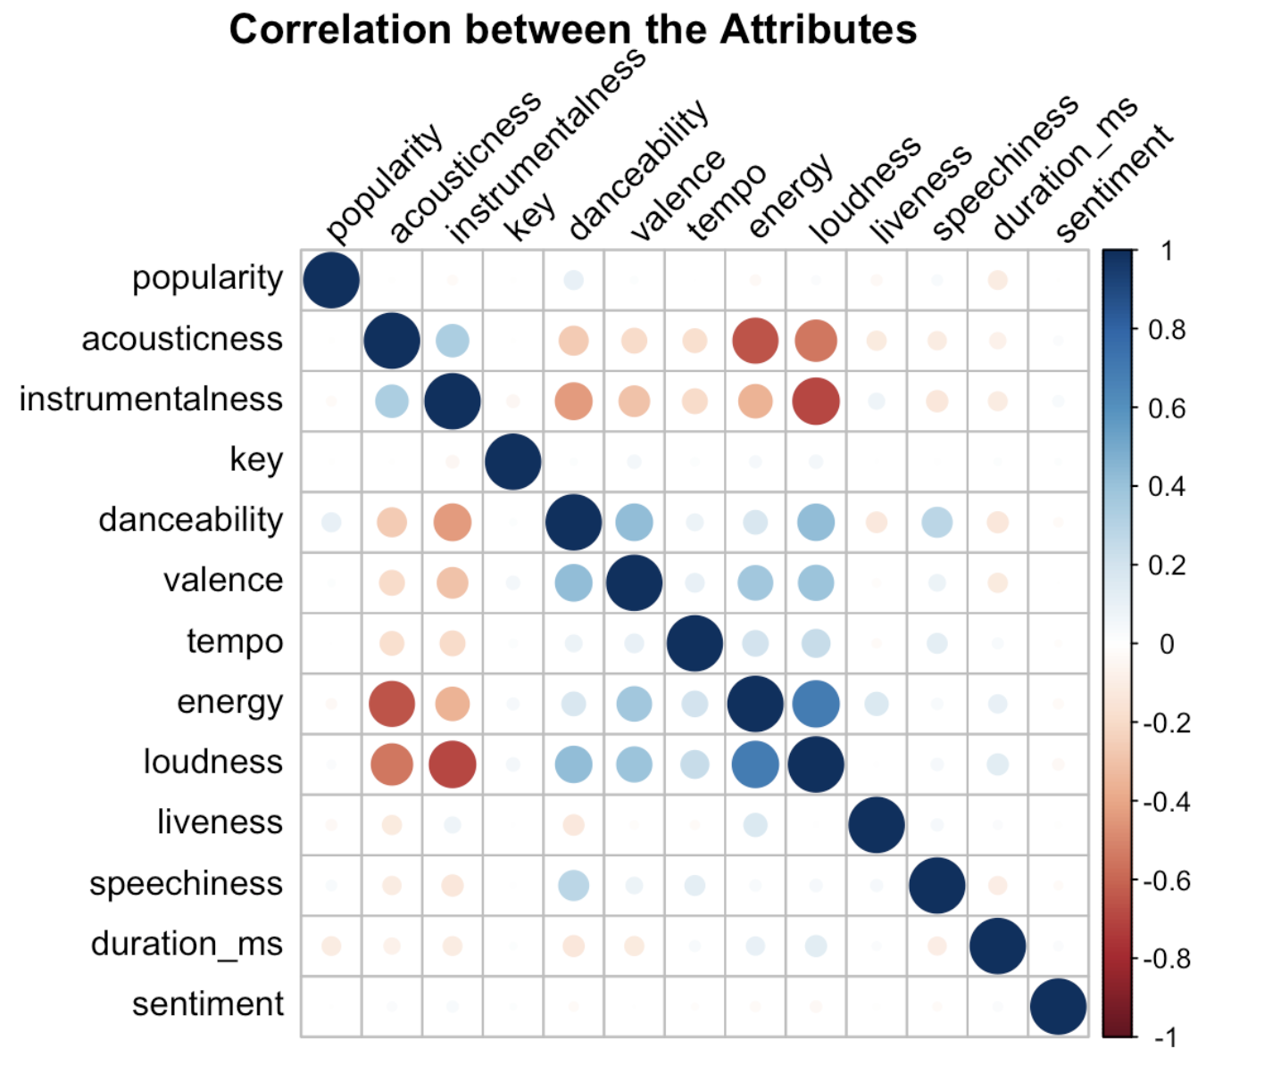
c
Positive correlation between danceability & valence, so is valence with speechiness & danceability.
Strong correlation between loudness and energy, instrumentalness and acousticness.
High negative correlation between energy, loudness and acousticness, so is danceability and instrumentalness.
Positive correlation between popularity and danceability, whereas there is a negative correlation between duration and popularity.
Notes:
We could see strong correlation between some attributes. For example, loudness is highly positively correlated with danceability and valence, so is valence with speechiness with danceability. There is a strong correlation between loudness and energy. There is also a strong correlation between instrumentalness and acousticness.
In contrary, there is high negative correlation between energy, loudness and acousticness, so is danceability and instrumentalness, which makes sense as these attributes clearly indicates tracks of complete opposite genre.
It can also be inferred that there is a positive correlation between popularity and danceability, whereas there is a negative correlation between duration and popularity. These findings require further examination in the later parts.

Slide 12
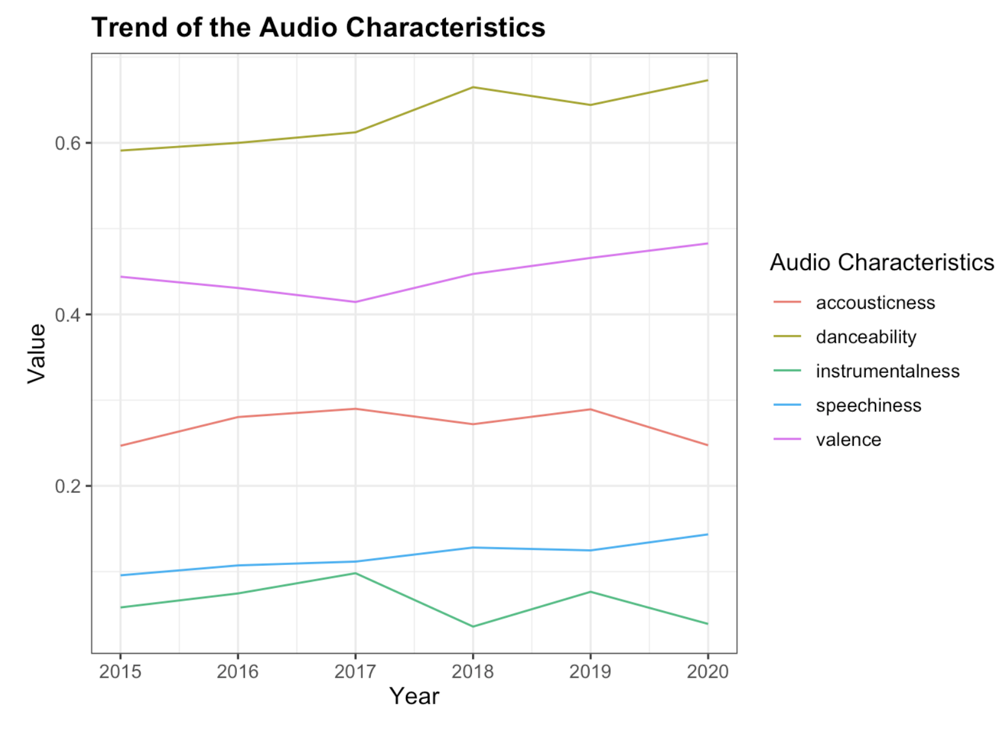
c
Tracks have become more danceable in the recent years, so is valence and speechiness.
Acousticness and instrumentalness move together with similar pattern in trend
Notes:
Audio attributes with significant differences throughout the years are included in the graph. As we can see, tracks have become more danceable in the recent years, so is valence and speechiness, which supports the previous correlation matrix that these highly correlated attributes has increased together.
Though we couldn't really infer that there is a decrease in the attribute on accousticness and instrumentalness in the recent years, we could see that these two attributes move together with the same pattern in trend.

Slide 13
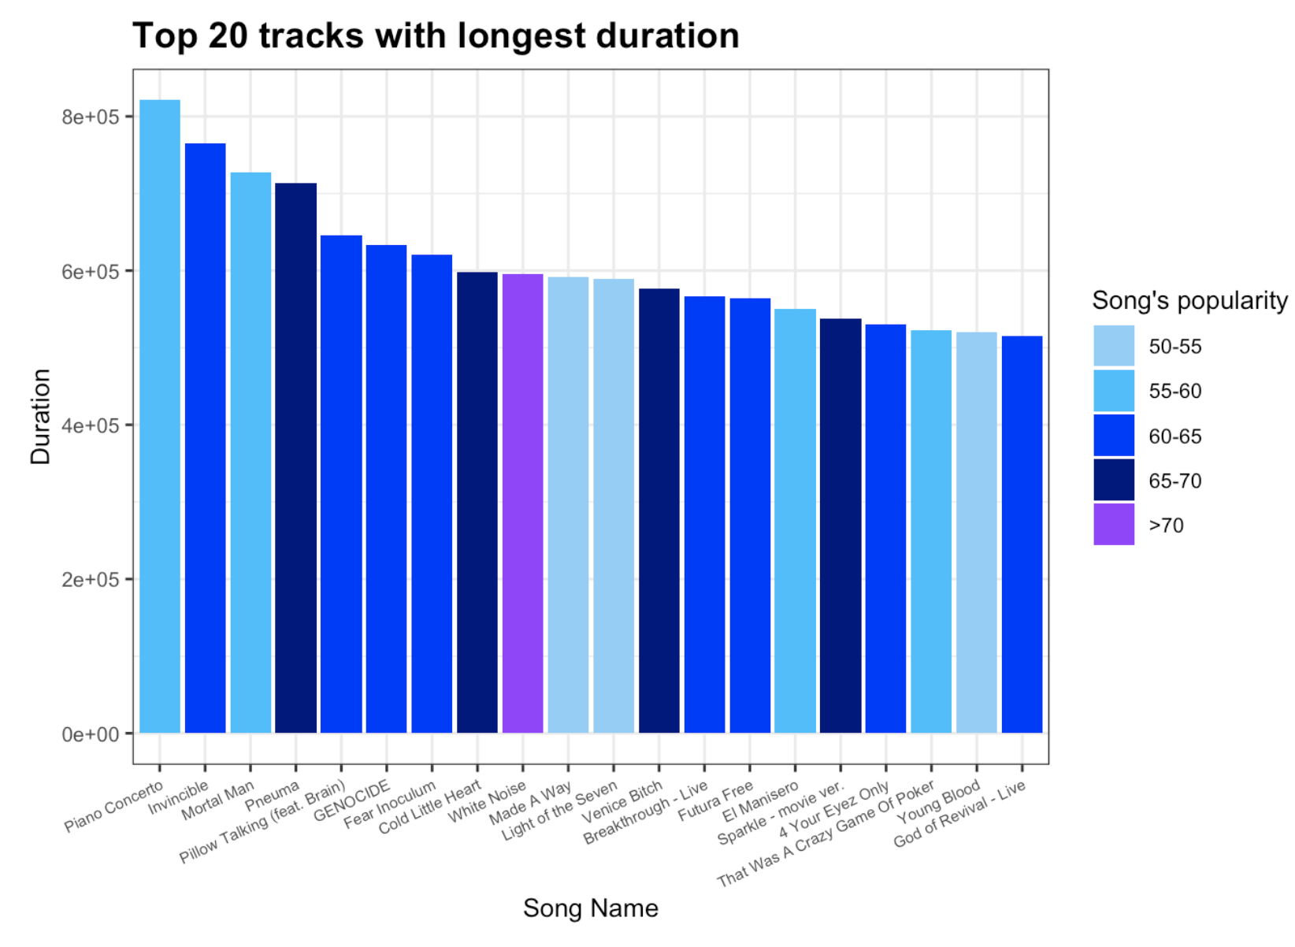
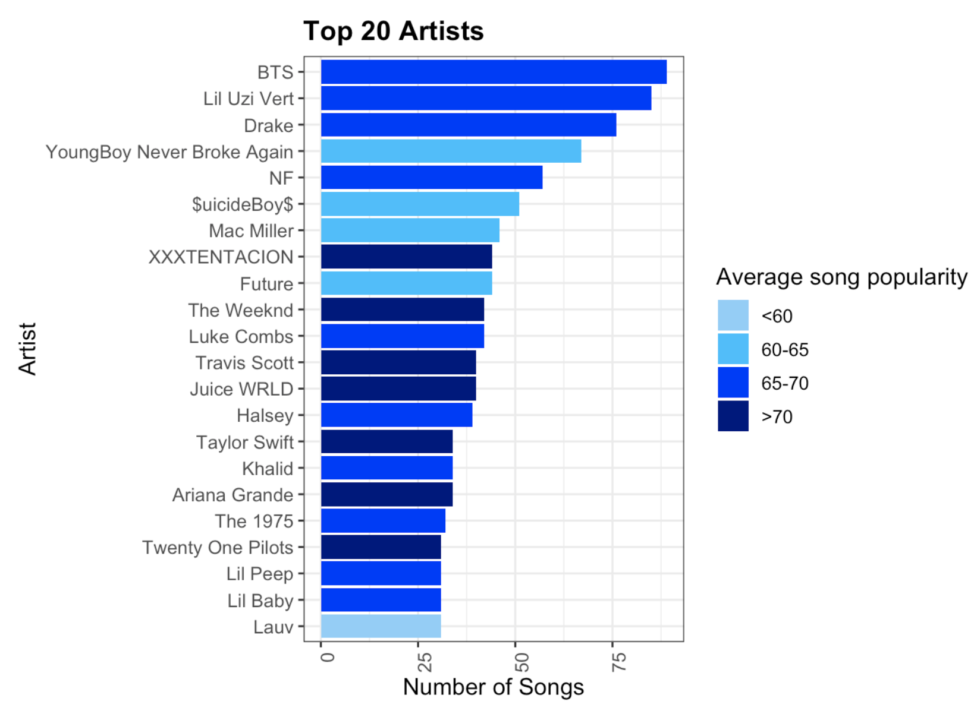
Notes:
Tracks with the longest duration are generally less popular, as out of the 20 tracks with longest duration, only 1 track has a popular score over 70. The other songs mostly falls within the popularity range of 50 to 65.
The artists that produced most songs in the recent years is BTS. Out of the top 20 artists that produced most songs, XXXTENTACION has the highest average song popularity, which ranks the artists as the top artist on Spotify in recent years.
The songs produced by the top 20 artists are generally popular as well, with only 1 of the artist has an average song popularity less than 60, and 7 of the artists has very high average song popularity exceeding 70.
Nearly all of the top 10 artists among the top 20 artists are Hiphop singers or rappers. Thus, at this point, we could predict that probably speechiness will be a high influential factor on popularity.

Slide 14
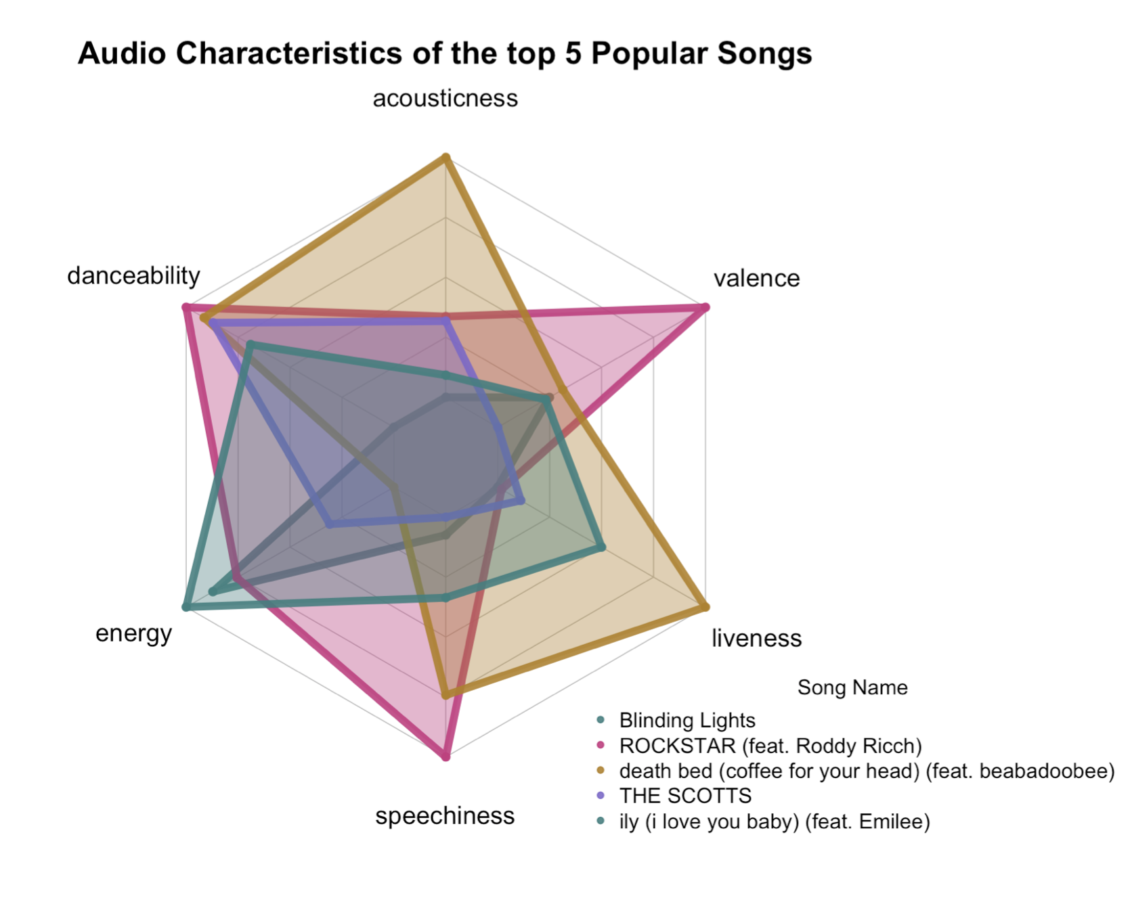
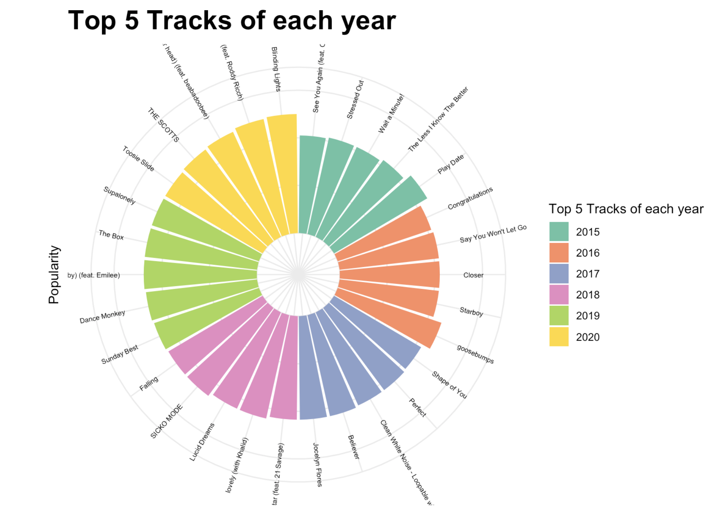
Notes:
From this chart, we can see that the top 5 tracks of each year are from different genres. For instance, the top 5 songs of 2017 consists of love songs, hiphop music, and background music that is without any lyrics. Thus, further examination need to be conducted to understand what is the influential factor for a track to be popular.
Most of these songs are from the top 20 artists shown above. Thus, artists' popularity could play a big part in determining the popularity of the track. Thus, we could explore further on the audio attribute of the tracks produced by the top artists.
The top 5 most popular songs in recent years are "Blinding Lights", "ROCKSTAR","death bed","THE SCOTTS" and "The Box". A commonality is that most of the songs tend to be high on danceability and energy, while accousticness is not a high factor for most of the popular songs.

Slide 15
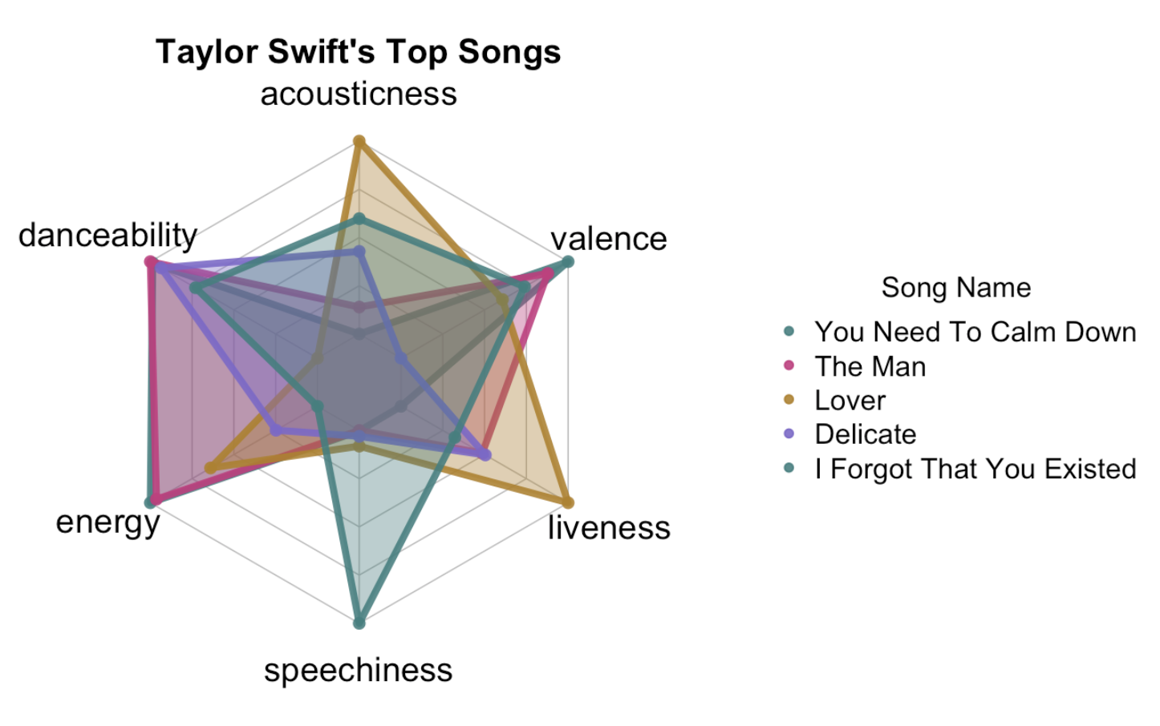
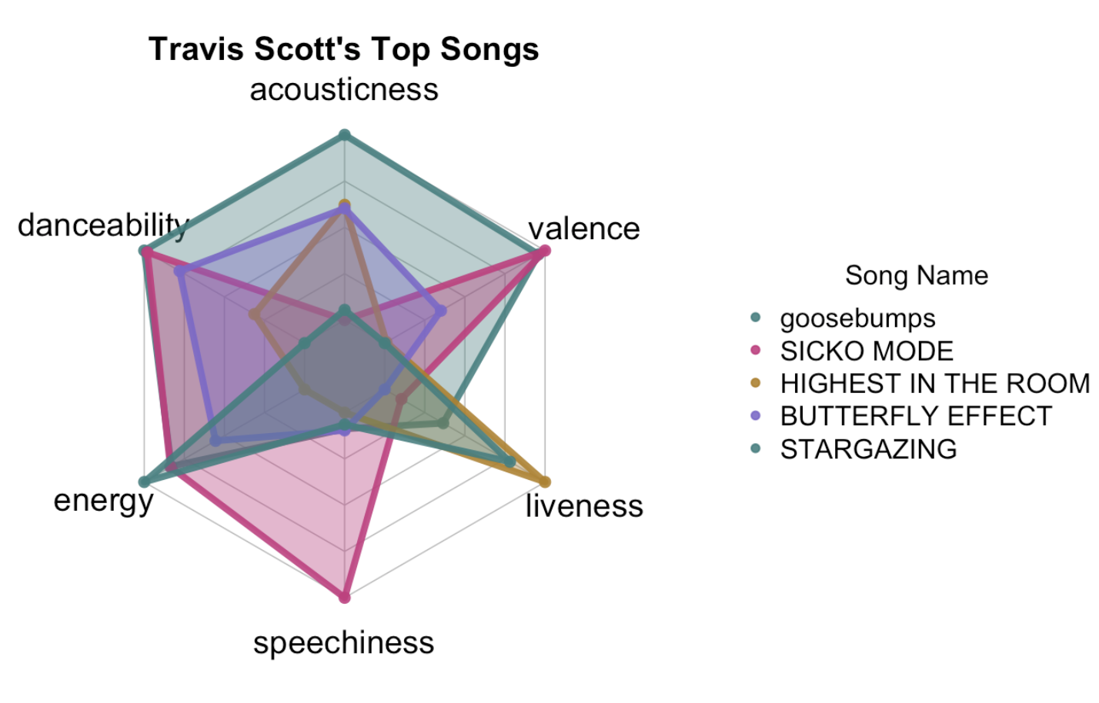
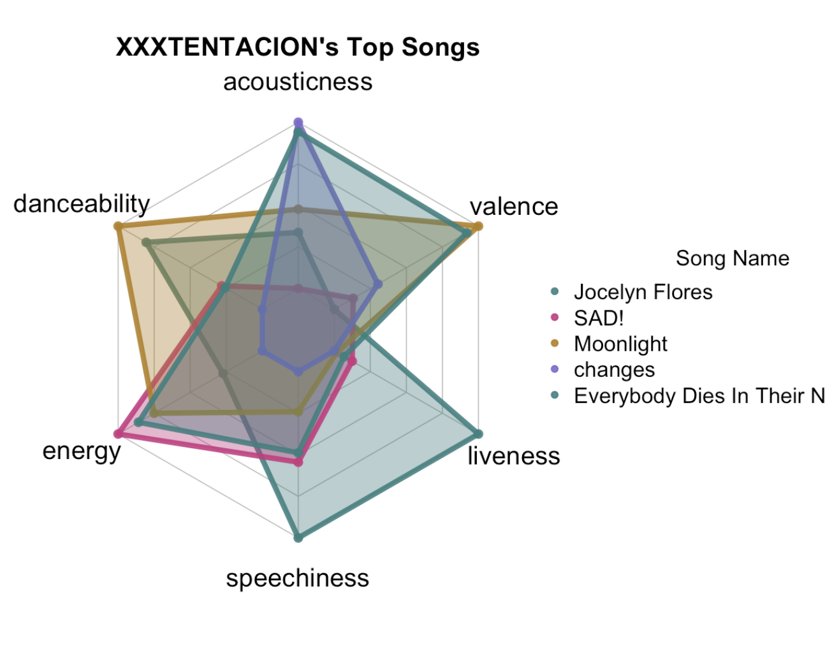
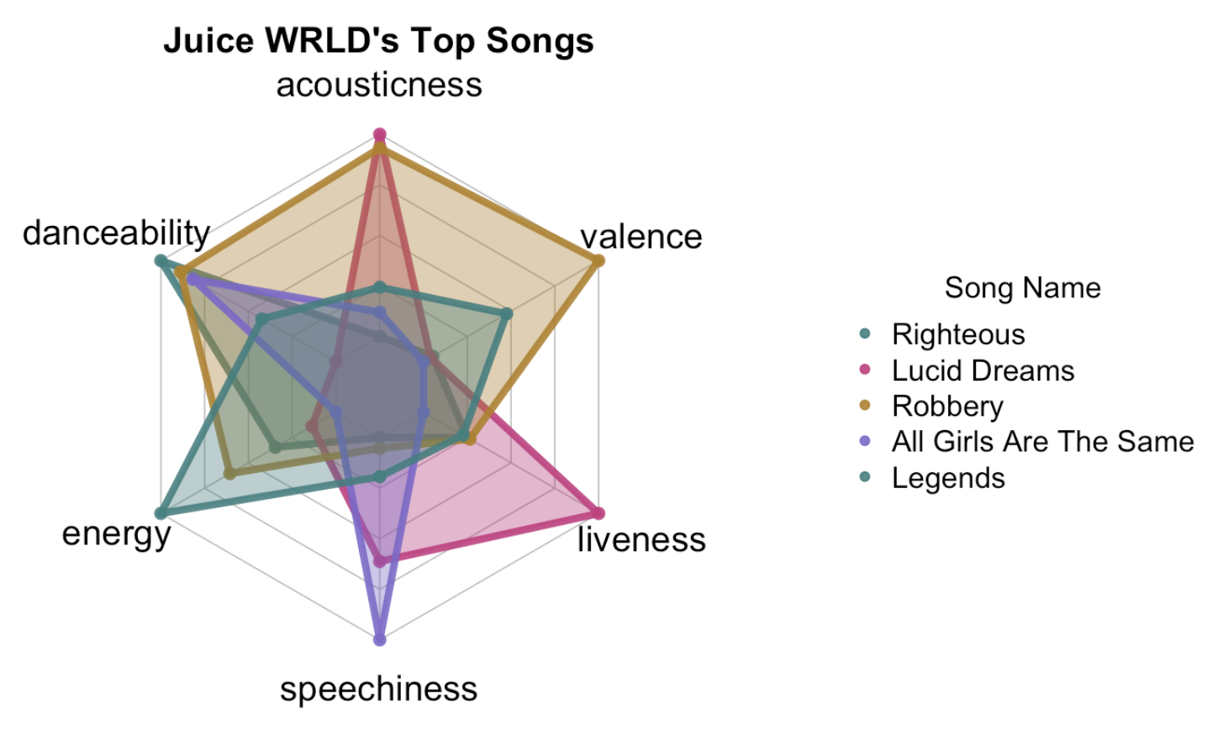
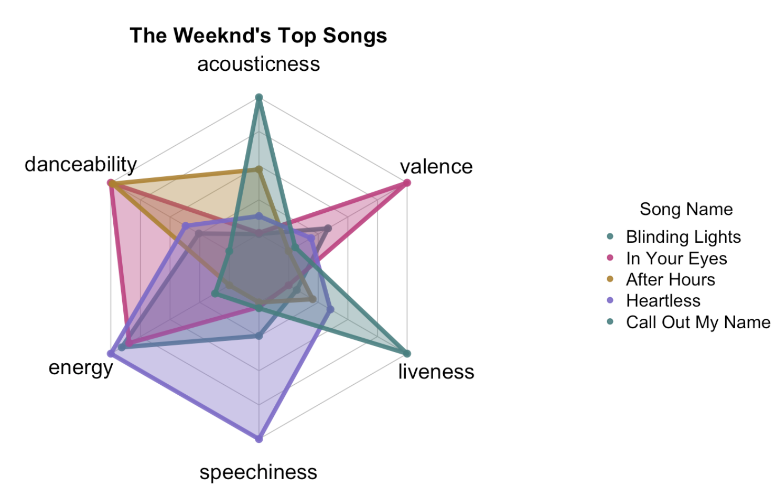
Notes:
From the top 20 artists, we have selected top 5 artists based on the number of songs they produced and the average popularity of their songs. The 5 artists selected are XXXTENTACION, The Weeknd, Travis Scott, Juice WRLD and Taylor Swift. The audio characteristics of each artists' top 5 songs are shown.
XXXTENTACION's songs are particular concentrated in the attribute acousticness, energy and danceability. Liveness is not a high factor for most of his songs.
The Weeknd's songs are generally highly danceable and with high energy.
Travis Scott's songs demonstrated a substantial diversity abilities. However, most of his songs tend to be low on speechiness factor.
Juice WRLD's songs are highly diversified as well, and mostly high on speechiness, energy, danceability.
Taylor Swift's songs are generally high in valence, danceability, energy, and relatively high on acoustiness.
The songs produced by these artists are generally highly danceable, energetic. Some artists' work display a clear emphasis in certain genre, while for most the artists, the attributes are relatively diverse, and thus further examination through models should be conducted to make further insightful inference.

Slide 16
03.
Text Analysis

Slide 17

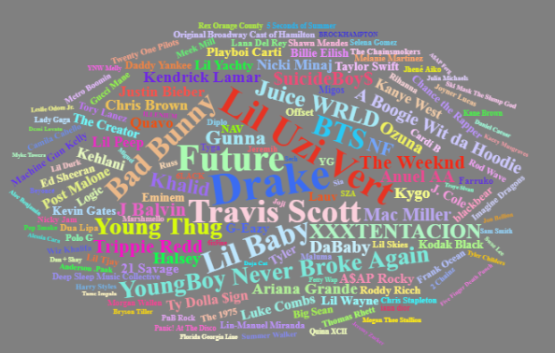

Word Cloud: Who are the most prolific artists?
Only artists with no less than 20 songs are shown in the graph.
More songs an artist published, larger the size the artist name is.
The most prolific singer is Drake, producing 157 songs, followed by Lil Uzi Vert, Future, Travis Scott, Lil Baby, Bad Bunny and BTS with more than 100-song productions.

Slide 18
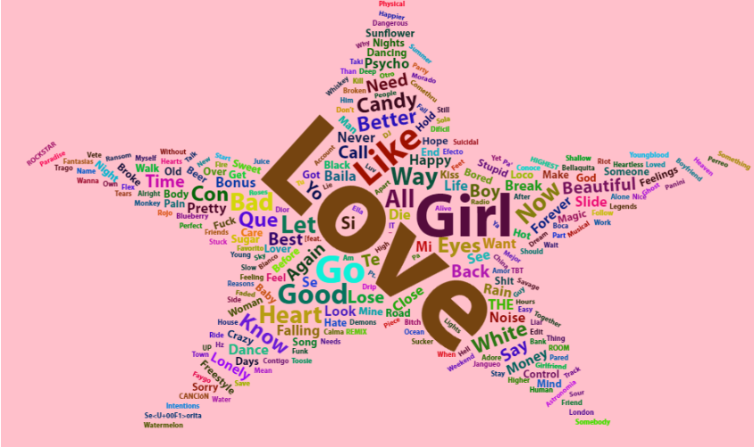
Word Cloud: Are popular songs using the same song names?
Only words appeared no less than 2 times are shown.
The more common a word is, the bigger the word is.
The most frequent words appeared in song names is ‘Love’, showing 36 times, followed by ‘Girl’, ‘Go’ and ‘Like’ with more than 10 times occurrence.

Slide 19
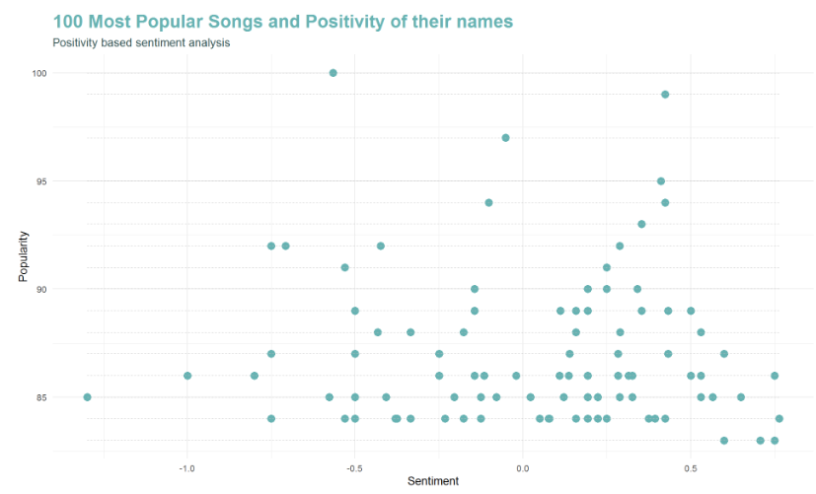
Sentiment Analysis: (Song) Popularity and (Song Name) Positivity
No clear correlation between popularity and sentiment.

Slide 20
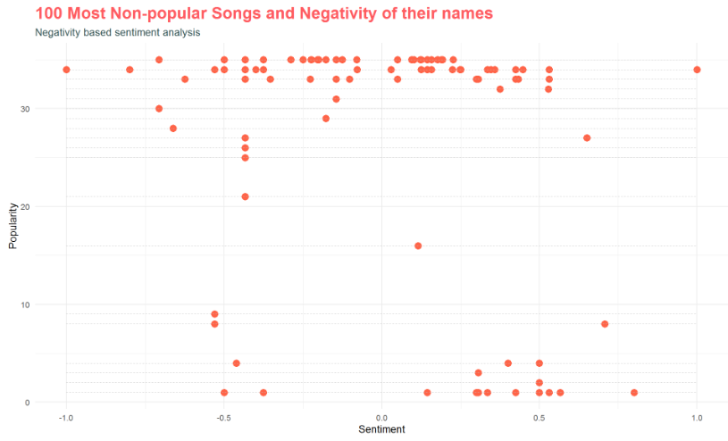
Sentiment Analysis: (Song) Non-popularity and (Song Name) Negativity
No clear correlation between popularity and sentiment.
We may consider to exclude sentiment when building model to explain popularity.

Slide 21
04.
Modeling & Results
Data Preparation
First Model-Logistic Regression
Second Model-Decision Tree
Third Model-Random Forest
Modeling Insights

Slide 22
01.
Background Information
02.
Data Visualizations
03.
Modeling & Results
04.
Recommendations

Slide 23
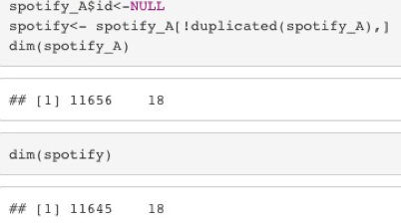
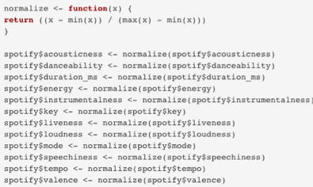
DATA PREPARATION
Normalization
In the previous visualization section, we see that different attributes have different measurement scales, so before starting to build the model, we need to normalize the data.
By comparing the number of songs before and after removing duplicated values, we can see that the original dataset has some duplicated values, so we use the data machine after removing duplicate values.
Check Duplicated

Slide 24

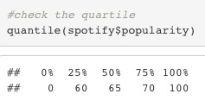

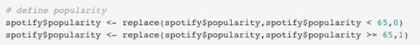

DATA PREPARATION
Define Popularity
We first check the quartile range of popularity to determine the threshold that defines whether the song is popular
Because 50% of the original popularity data is above 65, we decided to use 65 as the threshold for judging whether a song is popular. Those higher than the number are defined as popular, those lower than it or equal to it are defined as unpopular. Popularity is used as the dependent variable.

Slide 25

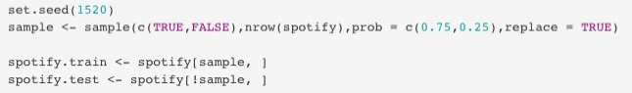

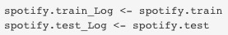

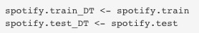



DATA PREPARATION
Define training set and test set
At the end of this part, we define the training set and the test set, and each model uses this set of data, so we can compare models.

Slide 26

Regression
Regression

Slide 27
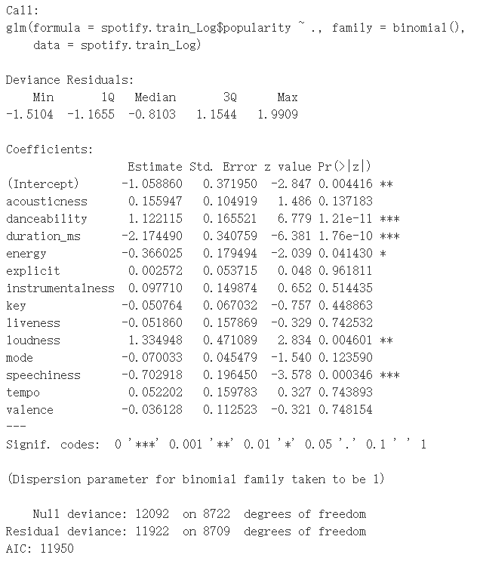
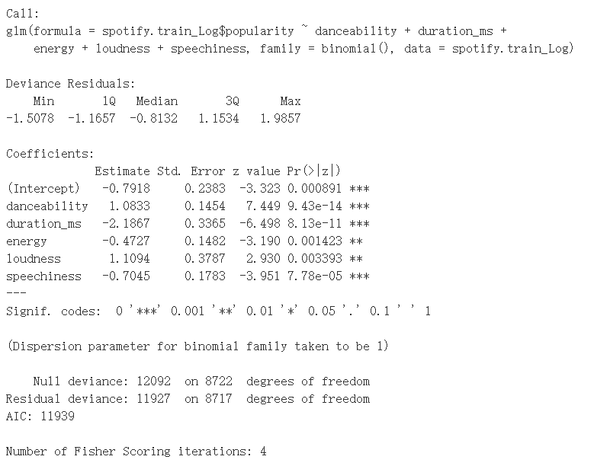
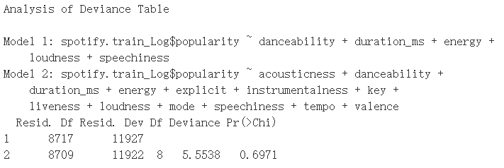
Logistics
Regression
Logistics Regression – Build the Model
The full model
The simplified model
Model Evaluation
Remove all irrelevant variables
Two models are equally good
The simplified model indicate that danceability, duration, energy, loudness and speechiness are significantly correlated to the popularity of a song.

Slide 28
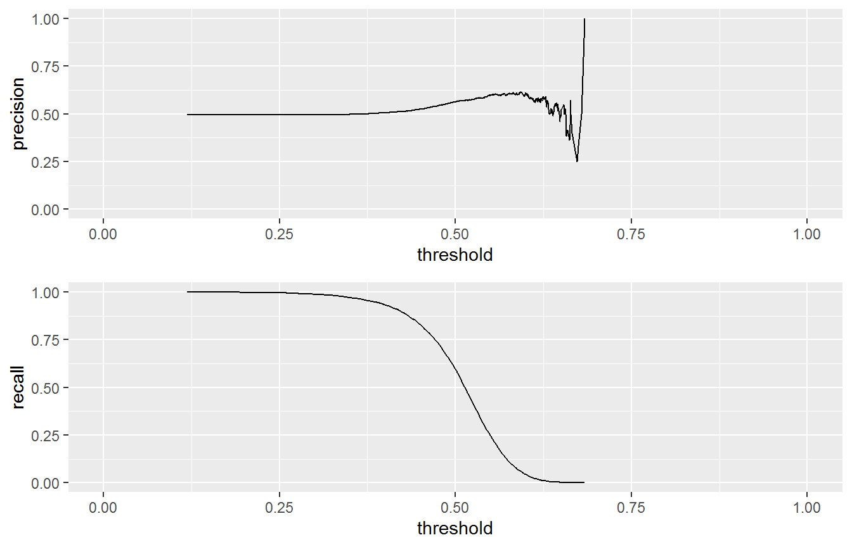
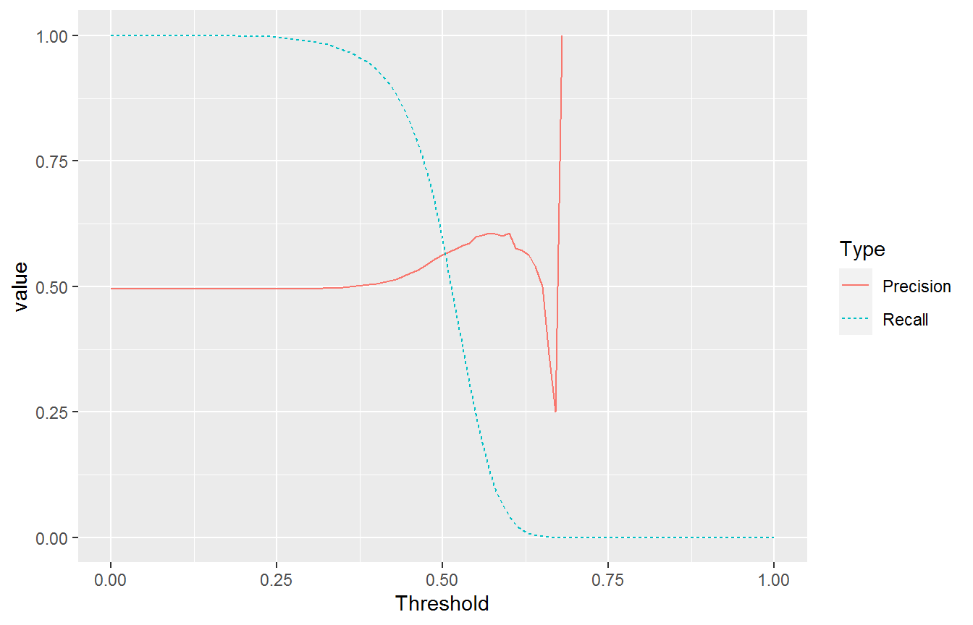
Logistics
Regression
Logistics Regression – Tradeoff between precision and recall
If we pick a threshold above 0.5, the precision of the classifier will not be improved significantly while the recall will decrease dramatically
Pick 0.5 as the threshold
Confusion Matrix
 | Popular
Predict | No | Yes
False | 765 | 629
True | 651 | 877
Final Score
Precision | 0.574
Recall | 0.582

Slide 29
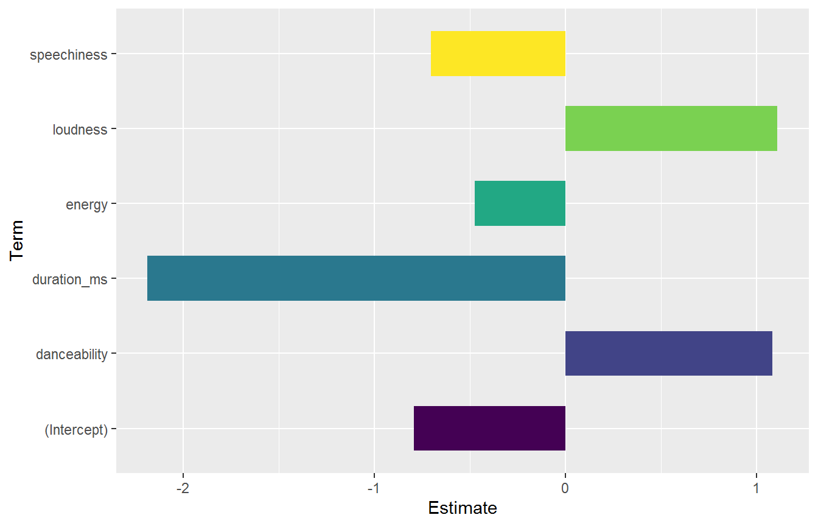
Logistics
Regression
Logistics Regression – Important features
A louder and danceable song has a higher probability to be popular.
If all other characteristics are the same, for a danceable song, the odd of being popular is exp(1.0833)=2.9544 times of a nondanceable song.
The popularity of a song is negatively correlated to ‘duration_ms’,‘energy’ and ‘speechiness’.

Slide 30

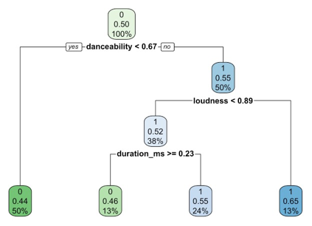
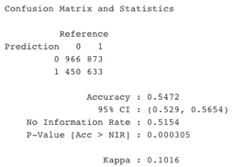


Decision Tree
Decision Tree – Build the Model
From the decision tree, we can see that a song is most likely to be popular if it has higher level of danceability, loudness and less likely to be popular if it has longer duration_ms.
The accuracy of this model is 0.5472. We can try to improve the accuracy of the model by checking the cp value and pruning.

Slide 31
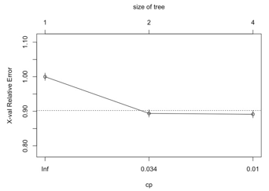
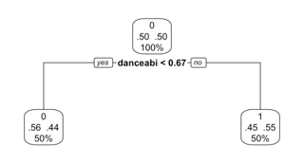
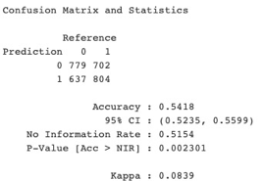

Decision Tree
Decision Tree – CP value & Prune
CP value = 0.034
From the graph, we decided that we can try different model with different cp values, so that we can find out the best one.
After pruning, the only variable that can be used to explain whether a song is a popular song is the danceability, and the accuracy drops to 0.5418. It seems that when the cp value = 0.034, the performance of the model is not enhanced.

Slide 32
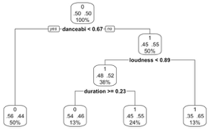
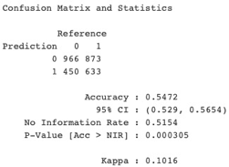
Decision Tree
Decision Tree – CP value & Prune
CP value = 0.01
Through pruning and checking the cp value, we found that the most accurate model is still our original model.
But the accuracy of this model is only 0.5472, which is even worse than the accuracy of the logistic model used before. We decided to try random forests to see if we would get better results.
From the graph, we decided that we can try different model with different cp values, so that we can find out the best one.

Slide 33
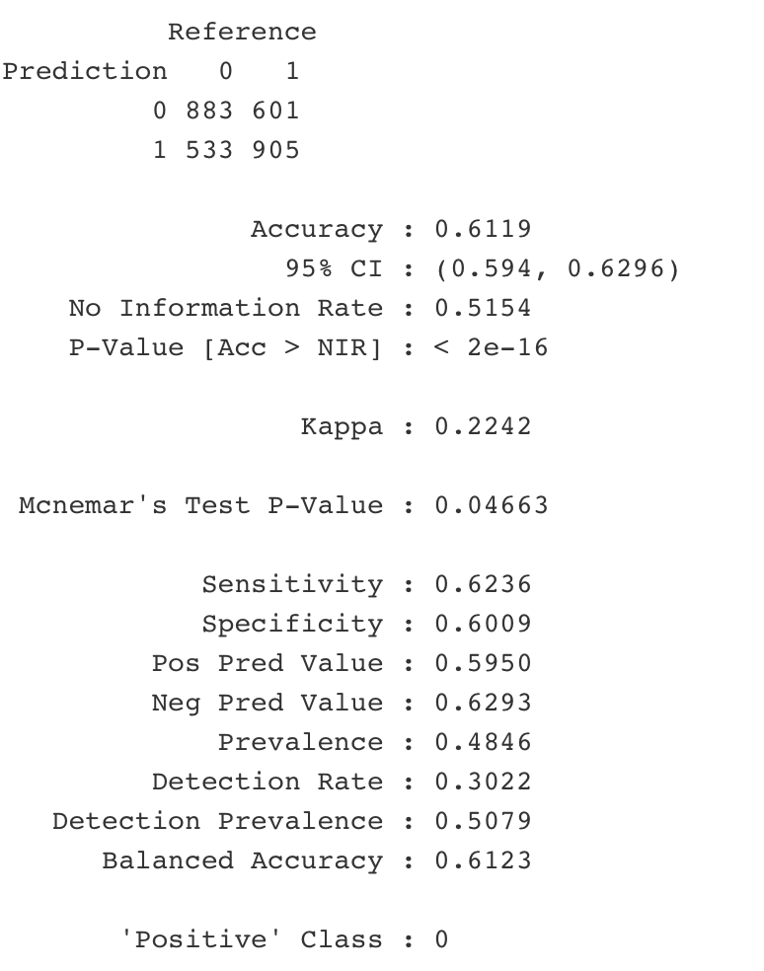
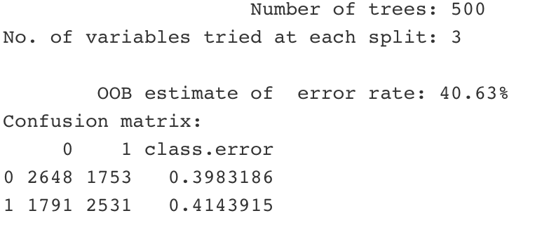

Random Forest
Train_Model
Test_Model
Accuracy over 60%, which is better than the previous two models
Out of bag (OOB) error rate is nearly 40%.
This model does a terrible job identifying which song is popular rather than unpopular.
Notes:
Our last model is random forest, which is a way of averaging multiple deep decision trees, trained on different parts of the same training set, with the goal of overcoming over-fitting problem of individual decision tree.
To build this model, we set 500 trees, which is sufficient to stabilise the error rate.
After running our training data, one thing to notice is that the out of bag (OOB) error rate is nearly 40%.
Another thing is in the confusion matrix, by comparing two class error rate, it can be seen that this algorithm does a terrible job identifying which song is popular rather than unpopular.
To complete this model, then we run our test dataset, the result shows here that the accuracy rate of our model is over 60%, which is higher than the previous two model, that the reason we choose this model for the further analysis.

Slide 34
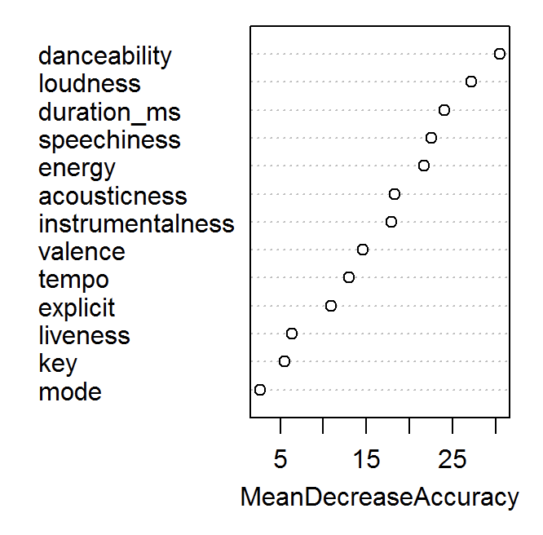
Random Forest
Random Forest – Variable Importance
The attributes like danceability, loudness and songs duration are relatively important to determine whether a song would be popular or not, while the attributes like mode, key are not significant enough.
Notes:
Here we start to find the variable importance of our model. According to the MeanDecreaseAccuracy plot here, which means How much the model accuracy decreases if we drop that variable, we could conclude that the attributes like danceability, loudness and songs duration are relatively important to determine whether a song would be popular or not.

Slide 35


Modeling Insights
The Highest accuracy model produced by Random Forest → final decision-making tool.
Variables like danceability, loudness and duration are related to the popularity of songs in last five years.
The higher the danceability of the song, the higher the loudness, while other factors remain unchanged, the song is more likely to be popular.
However, when the duration is longer while other factors remain the same, the song is more likely to be unpopular.
In order to become a popular song in recent years, it should be made with strong rhythm, loudness with relative short time duration. Additionally, The more in line with these characteristics, the more likely the song is a popular song.
Notes:
By trying different models, we finally have the highest accuracy model produced by using random forest. We will use it as the final decision-making tool.
We can see from the songs produced in the last five years, the factors related to the popularity of the song are undoubtedly danceability, loudness and duration_ms.
Combining the three models, it is not difficult to see that the higher the danceability of the song, the higher the loudness, while other factors remain unchanged, the song is more likely to be popular. However, when the duration_ms is higher while other factors remain the same, the song is more likely to be unpopular.
We can probably describe that in order of a song in recent years to become popular, it should be a song with strong rhythm, loudness, and not too long. The more in line with these characteristics, the more likely the song is a popular song.
This is very helpful for Spotify to review new songs in recent years and invest funds in songs that are most likely to become popular.

Slide 36
05
Recommendations

Slide 37
01.
Background Information
02.
Data Visualizations
03.
Modeling & Results
04..
Recommendations

Slide 38


Recommendations
01.
Spotify is a well-known music service platform. The biggest advantage of Spotify is the sense of experience.
And its biggest source of income is users who are willing to pay for such services. However, Spotify has low profit margin due to high royalties paid.
02.
Spotify need to identify which songs to invest based on the song’s popularity.
Besides purchasing songs from well-known artists, which are favored by most audiences, Spotify should also include good works by new artists to increase on its variety.
Thus, a web tool that can help Spotify to determine whether a song will become popular will come in handy.
03.
In addition, we could see a change in the music trend in different time periods.
Through our model analysis, we can find that high danceability, high loudness and low duration_ms are the popular factors in recent years, and Spotify could make use of the tool to analyze the songs and improve on its service.

Slide 39
THANKS

